Slide 1
Entrypoints for International Advocacy on Tax Justice
A Feminist Approach

Slide 2
Content
A Feminist Approach to Tax Principles
Women as Taxpayers
Women’s Needs and Requirements
Other Taxpayers and the Impact of their Actions
Recommendations

Slide 3
1. Objectives of Taxation
Raise Revenues in an equitable manner
Redistribute income and wealth
Regulate the economy and society
Re-price goods and services
Recognise the role of ecosystems
Represent citizens/states as taxpayers

Slide 4
1. Missing Objective
A gender approach
Leveling the field based on needs

Slide 5
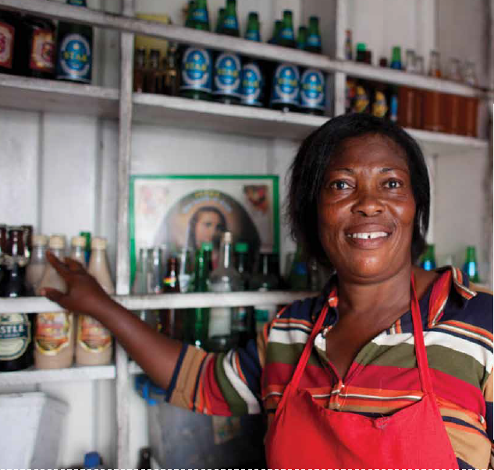
2. Women as Taxpayers IFFs are Already a Gendered Discussion
Notes:
How many of you have drunk a Castle, Stone Lager or Appletiser?
Not surprising because SABMiller is the world’s second largest multinational beercompany. Africas biggest brewer, operating in 31 African countries. The SABMiller group makes profits of over £2 billion a year
Marta, sells beer in a small kiosk outside its main brewery in Accra, Ghana. She works long days 6.30-8 and pays more tax from her little business than the whole brewery does in Ghana.
If multinational companies like SABMiller paid their taxes like Martha does, African countries would have enough money to for example stop the spread og HIV and AIDS and provide all children with a primary education.
This is what tax justice is about, and how it is linked to human rights.

Slide 6
3. Women’s Needs and Requirements

Slide 7
4. Other Taxpayers: Africa
854 billion to 1.8 trillion 1970-2008 (GFI 2010)
Sub-Saharan Africa 700 billion 1970-2008 (Ndikumana & Boyce 2011)
Grew at an average rate of 11.9% per annum
Outwiping debts of $250 billion in 2008
Less than Asia and LA in total numbers, more as percentage of national income (BNI)
Highest rate of poor (living on less than $1.25 per day) 47.5 % in 2008
Notes:
Growth:
The highest growth rates of illicit financial outflows from Sub-Saharan Africa over the last 30 years were recorded during the period from 2000 to 2008, a period of accelerated economic growth in the continent. It is noted that this increase was partly due to trade mis-invoicing during a period of increasing trade volumes. From an average of $17.8 billion per year in the 1990s, illicit financial flows shot to $50.3 billion per year on average during the period from 2000 to 2008 (GFI 2010)

Slide 8
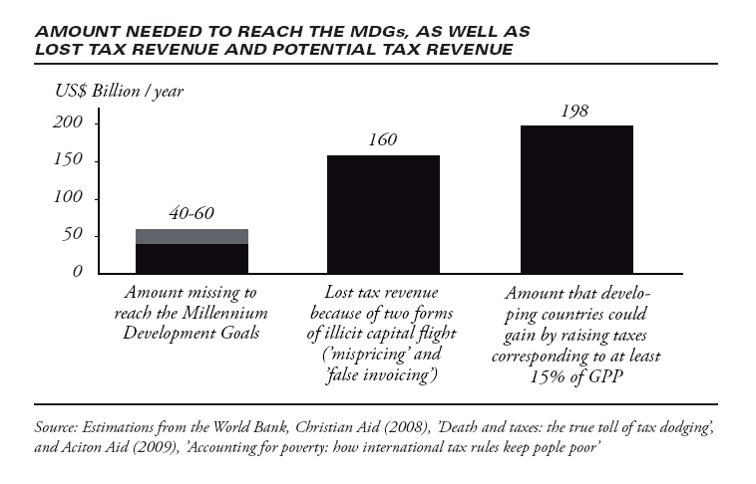
Notes:
Column in the middle shows the amount of tax revenue lost just through two forms of mispricing, 1, 5 times global aid
Left shows how much missing to reach the MDGs set by the UN. (Half extreme poverty till 2015, primary education for all) World bank estimations
Developing countries on average raise less than 15% of their national income as tax, developed countries 36%

Slide 9
5. Recommendations
Change in methods of budget presentations
UN treaty recognizing right to resource linkage
State recognition of rights requiring resources
Re-assessment of budget, exemptions, waivers in terms of lost revenue for potential services and public goods
Respect for human rights treaties
Upgrade UN Tax Committee

Slide 10
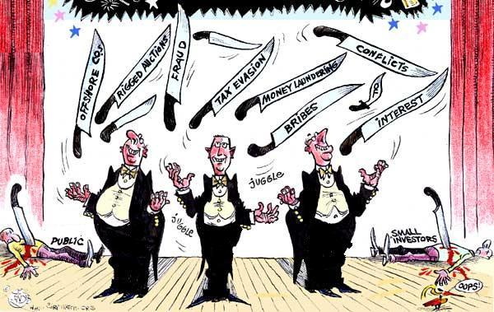
Where are the Women???
contact: attiya@uonbi.ac.ke
Notes:
10
10

